Slide 1

Smart meter in London data
Insights and modeling
Jay wang

Slide 2
There are three csv files used:
daily_dataset.csv
weather_daily_darsky.csv
Uk_bank_holidays.csv

Slide 3
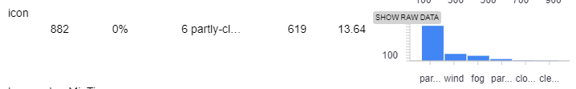
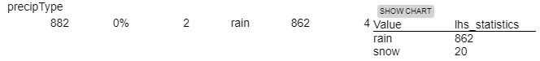
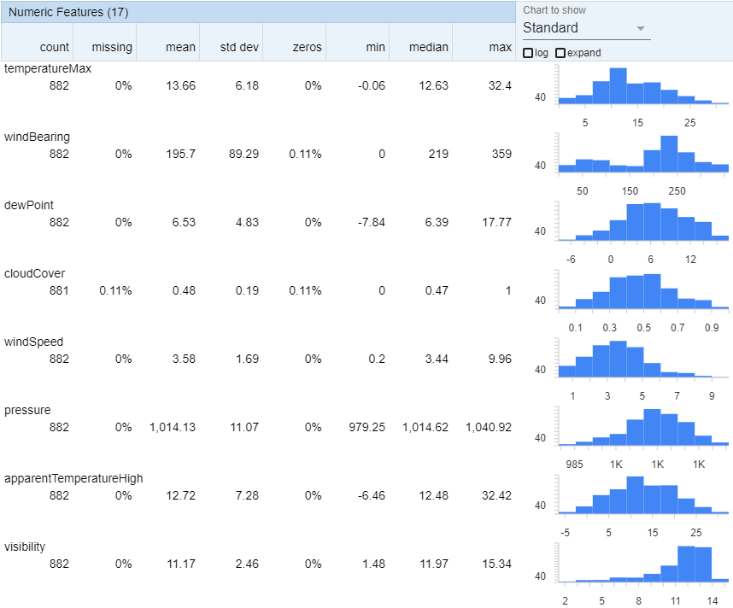
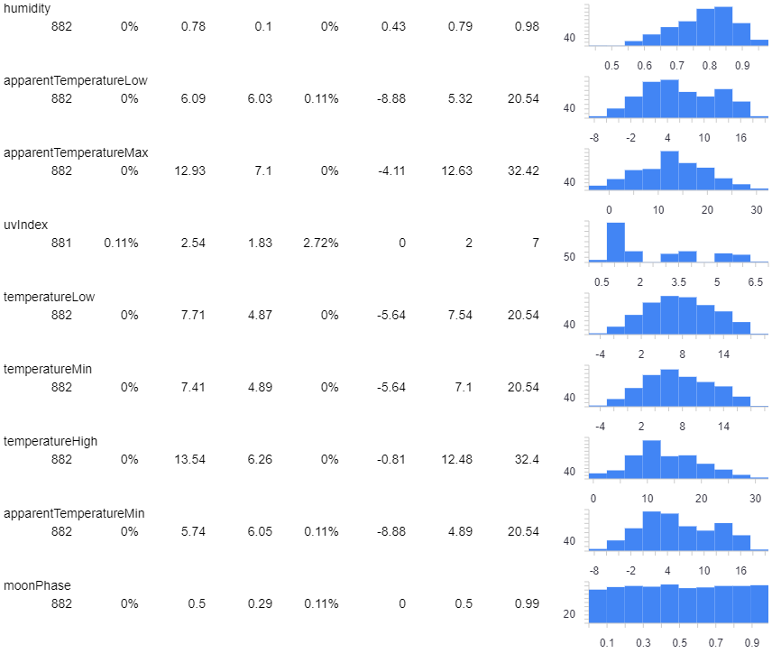
weather_daily_darsky.csv
882 rows, 32 features
There is 1 missing values in cloudCover and 1 in uvindex

Slide 4
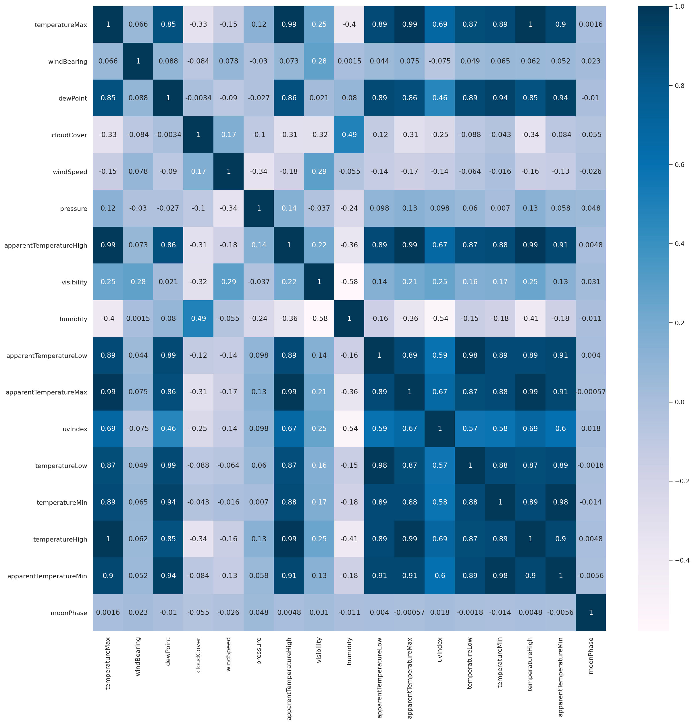
Heat map
apparentTemperatureMin, apparentTemperatureMax, dewpoint, apparentTemperatureHigh, apparentTemperatureLow, temperatureLow, temperatureMin, temperatureMax, temperatureHigh are highly correlated to each other.
Uvindex is correlated with above with slightly lower correlation coefficient ranging from 0.46 to 0.69.
moonPhase has the lease correlation to any of other features.

Slide 5
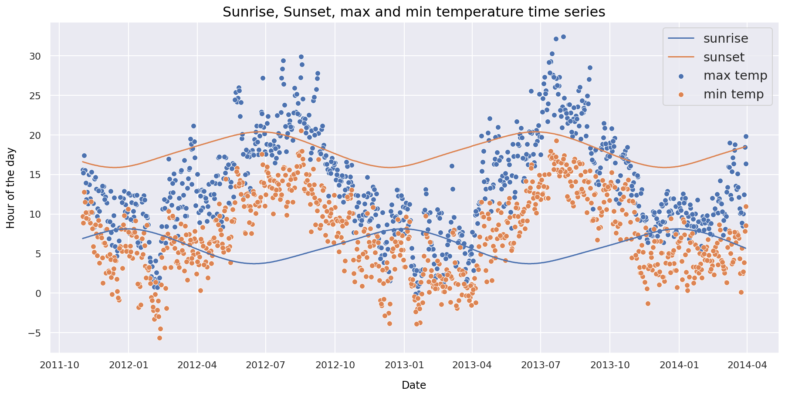
sunrise and sunset time time of the day, maximum daily temperature and minimum daily temperature are highly correlated.
July
July has the longest day with the highest temperature of the year.
January has the shortest day with the lowest temperature of the year.

Slide 6

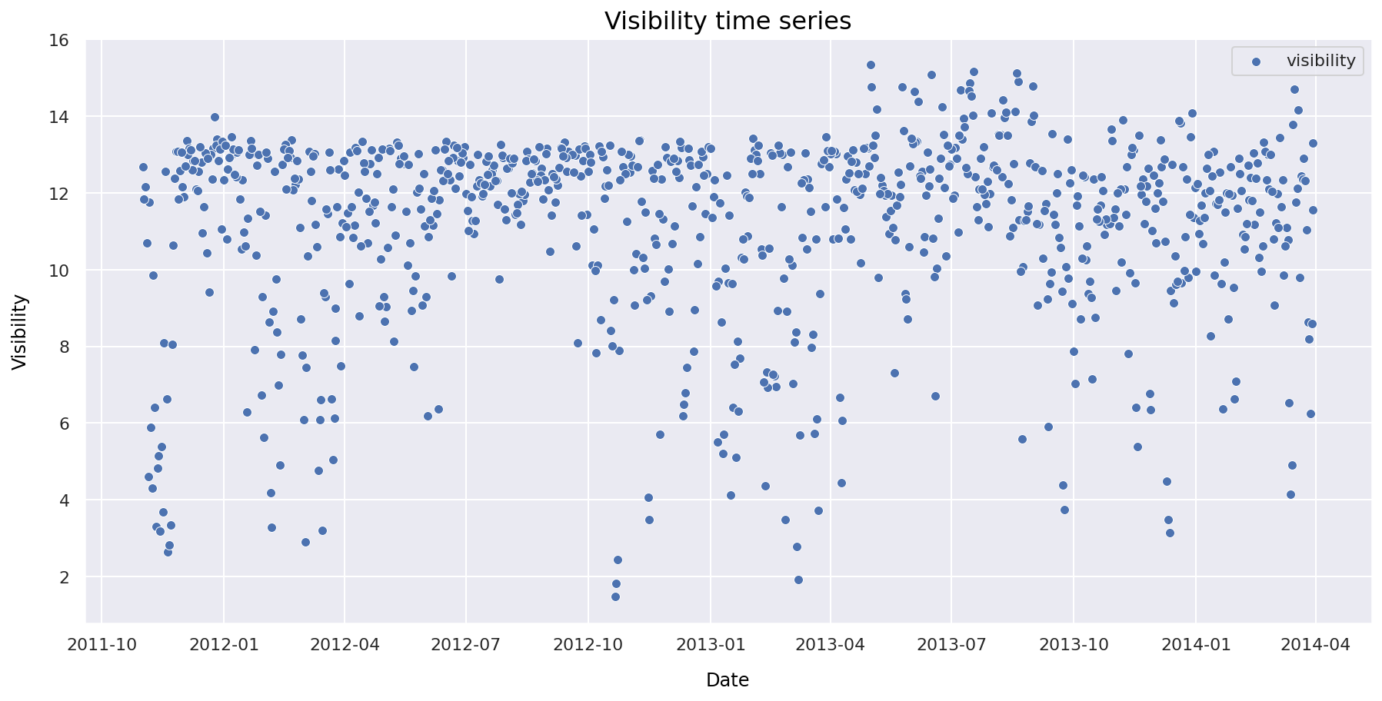
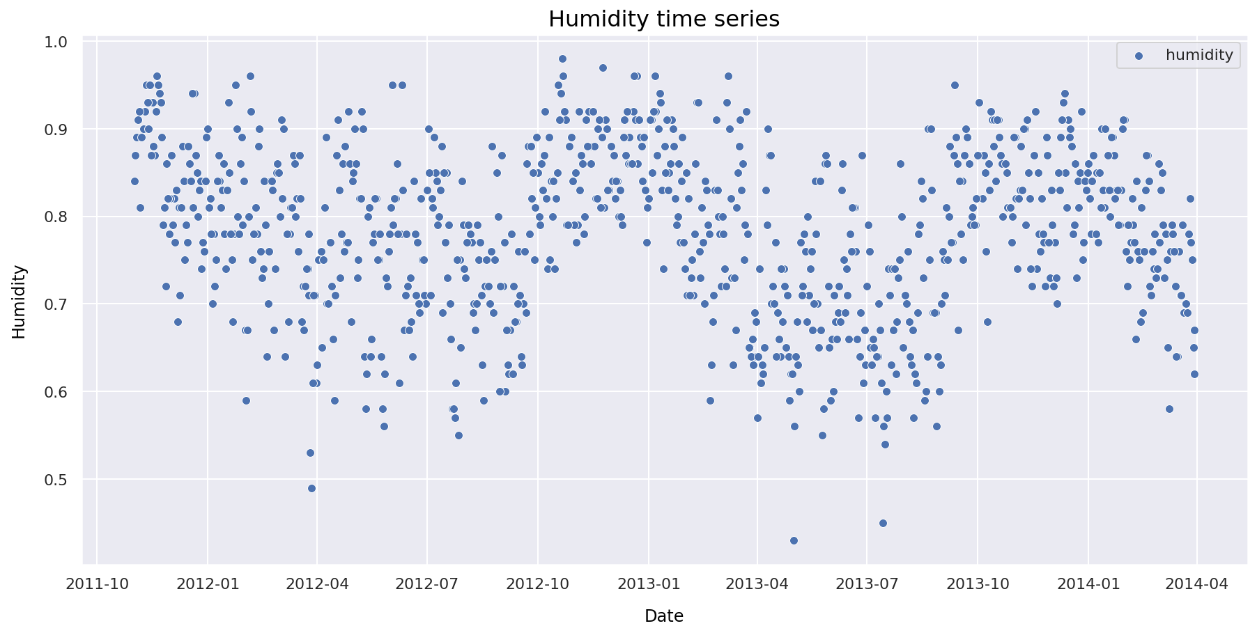
Visibility has a seasonal drop between October and April each year.
Humidity has a seasonal fluctuation, peak around January and drop in July in each year.

Slide 7
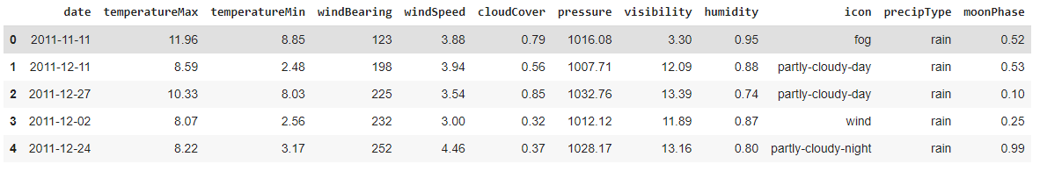
According to previous analysis and the curse of dimension, apparentTemperatureMin, apparentTemperatureMax, dewpoint, apparentTemperatureHigh, apparentTemperatureLow, temperatureLow, temperatureHigh, sunriseTime, sunsetTime, temperatureMaxTime, temperatureMinTime, apparentTemperatureMinTime, apparentTemperatureHighTime, temperatureHighTime, temperatureLowTime are drop. Time is removed from the time feature and renamed as date. Final weather dataset as follows.

Slide 8
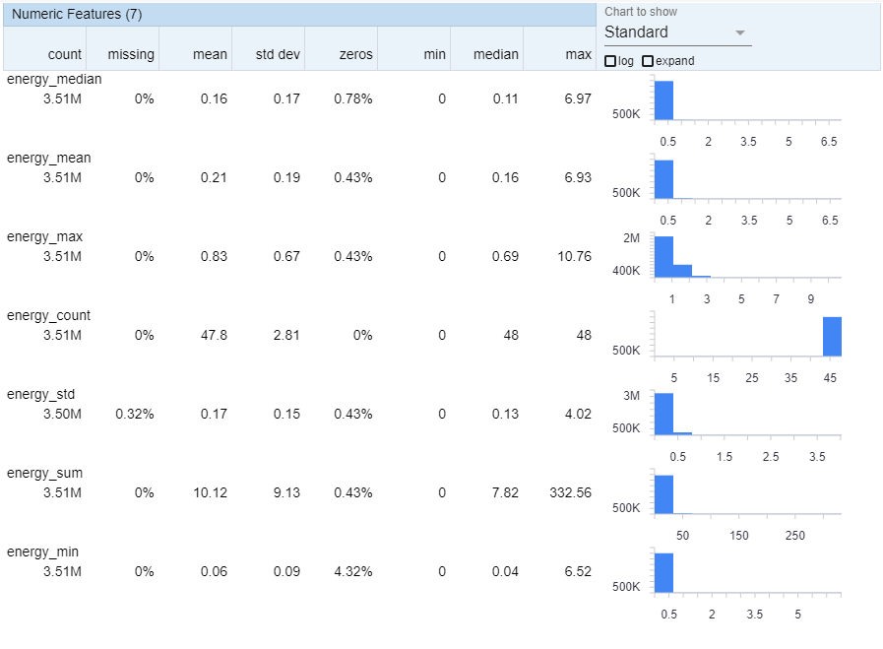
daily_dataset.csv 3,510,433 rows and 9 features 5566 unique users’ useage records in 829 days from 2011-11-23 to 2014-02-28. All numeric features are either left or right skewed. These might due to outliers.

Slide 9
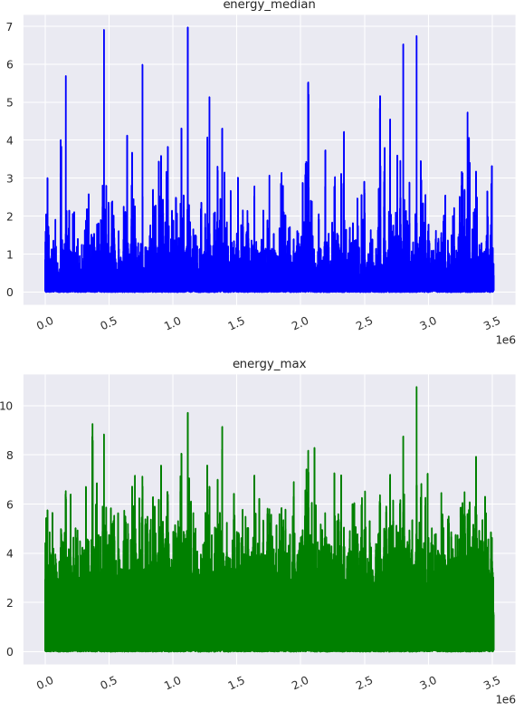
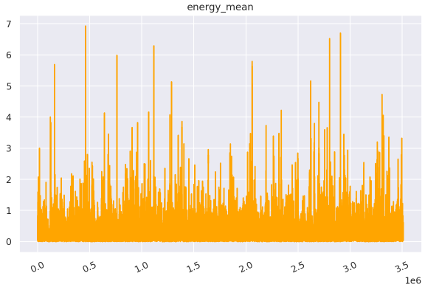
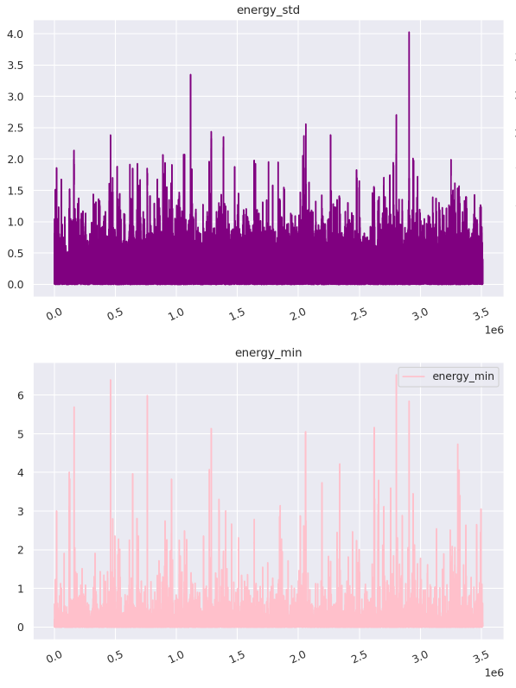
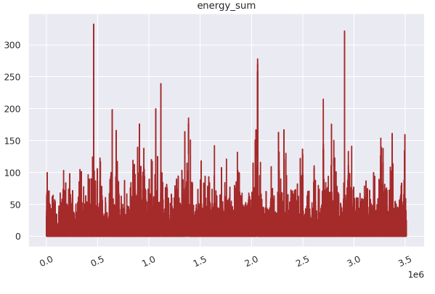
As mentioned before, most of the values are in a smaller range, they go up rarely.

Slide 10
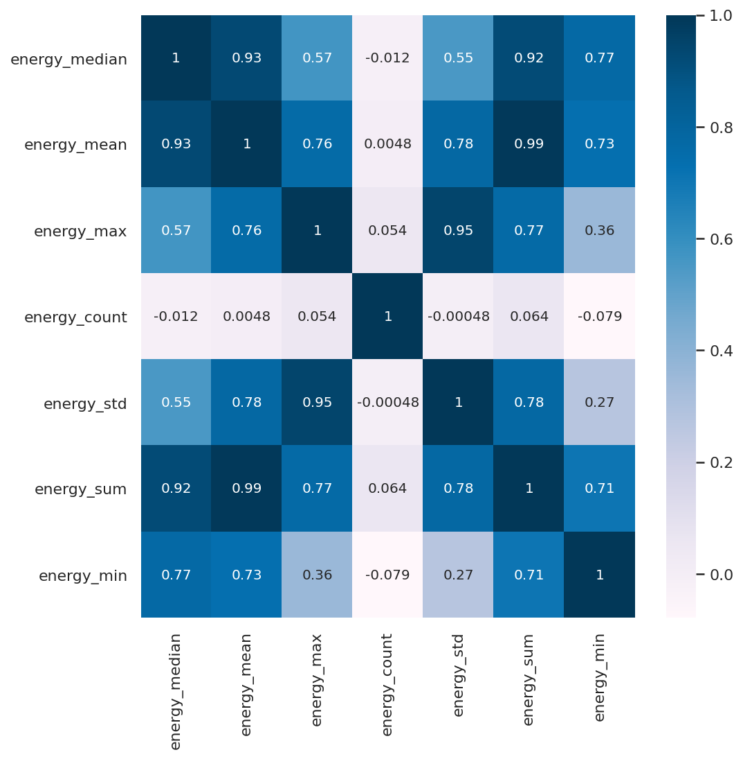
Apart from energy_count, they are highly correlated to each other.

Slide 11
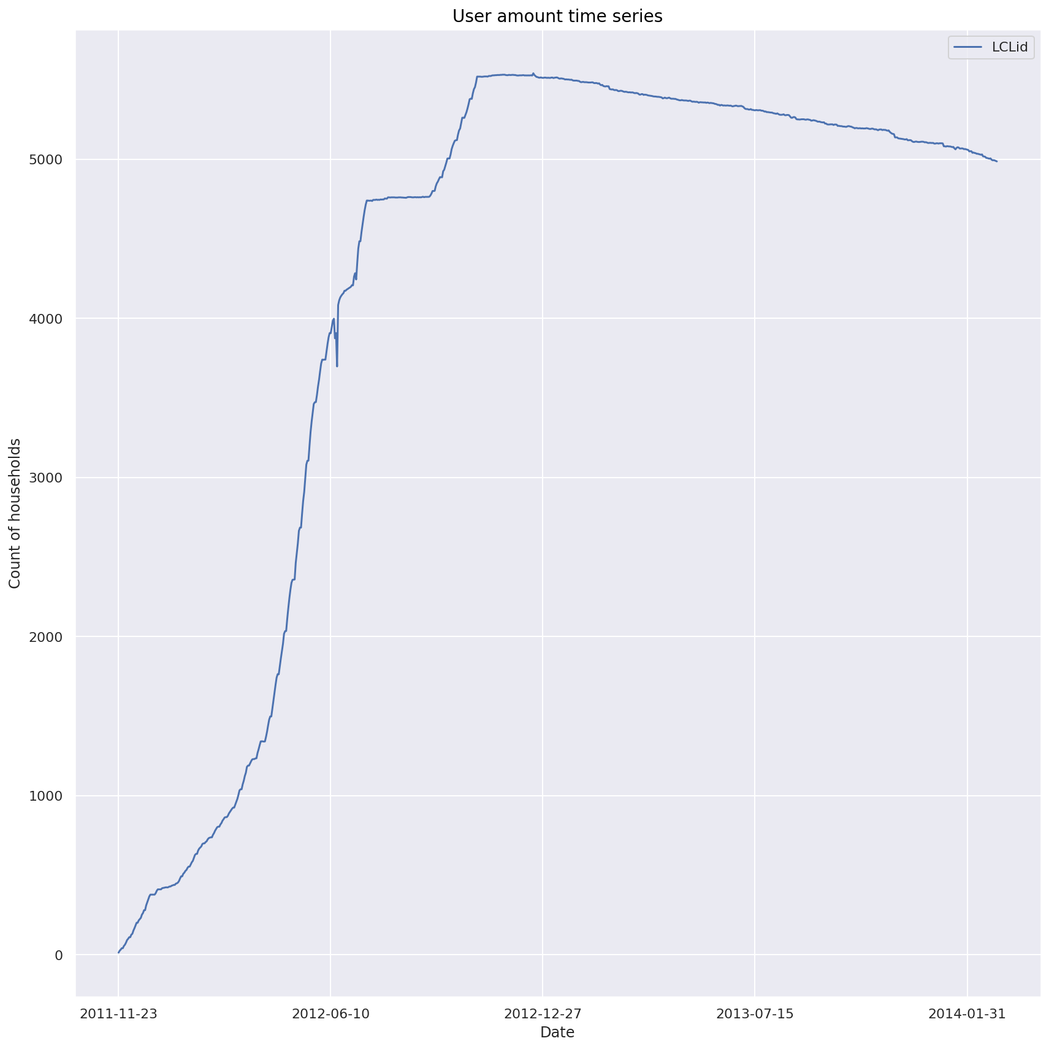
The users amount increases and peaked around the end of 2012. It started to drop since then.

Slide 12
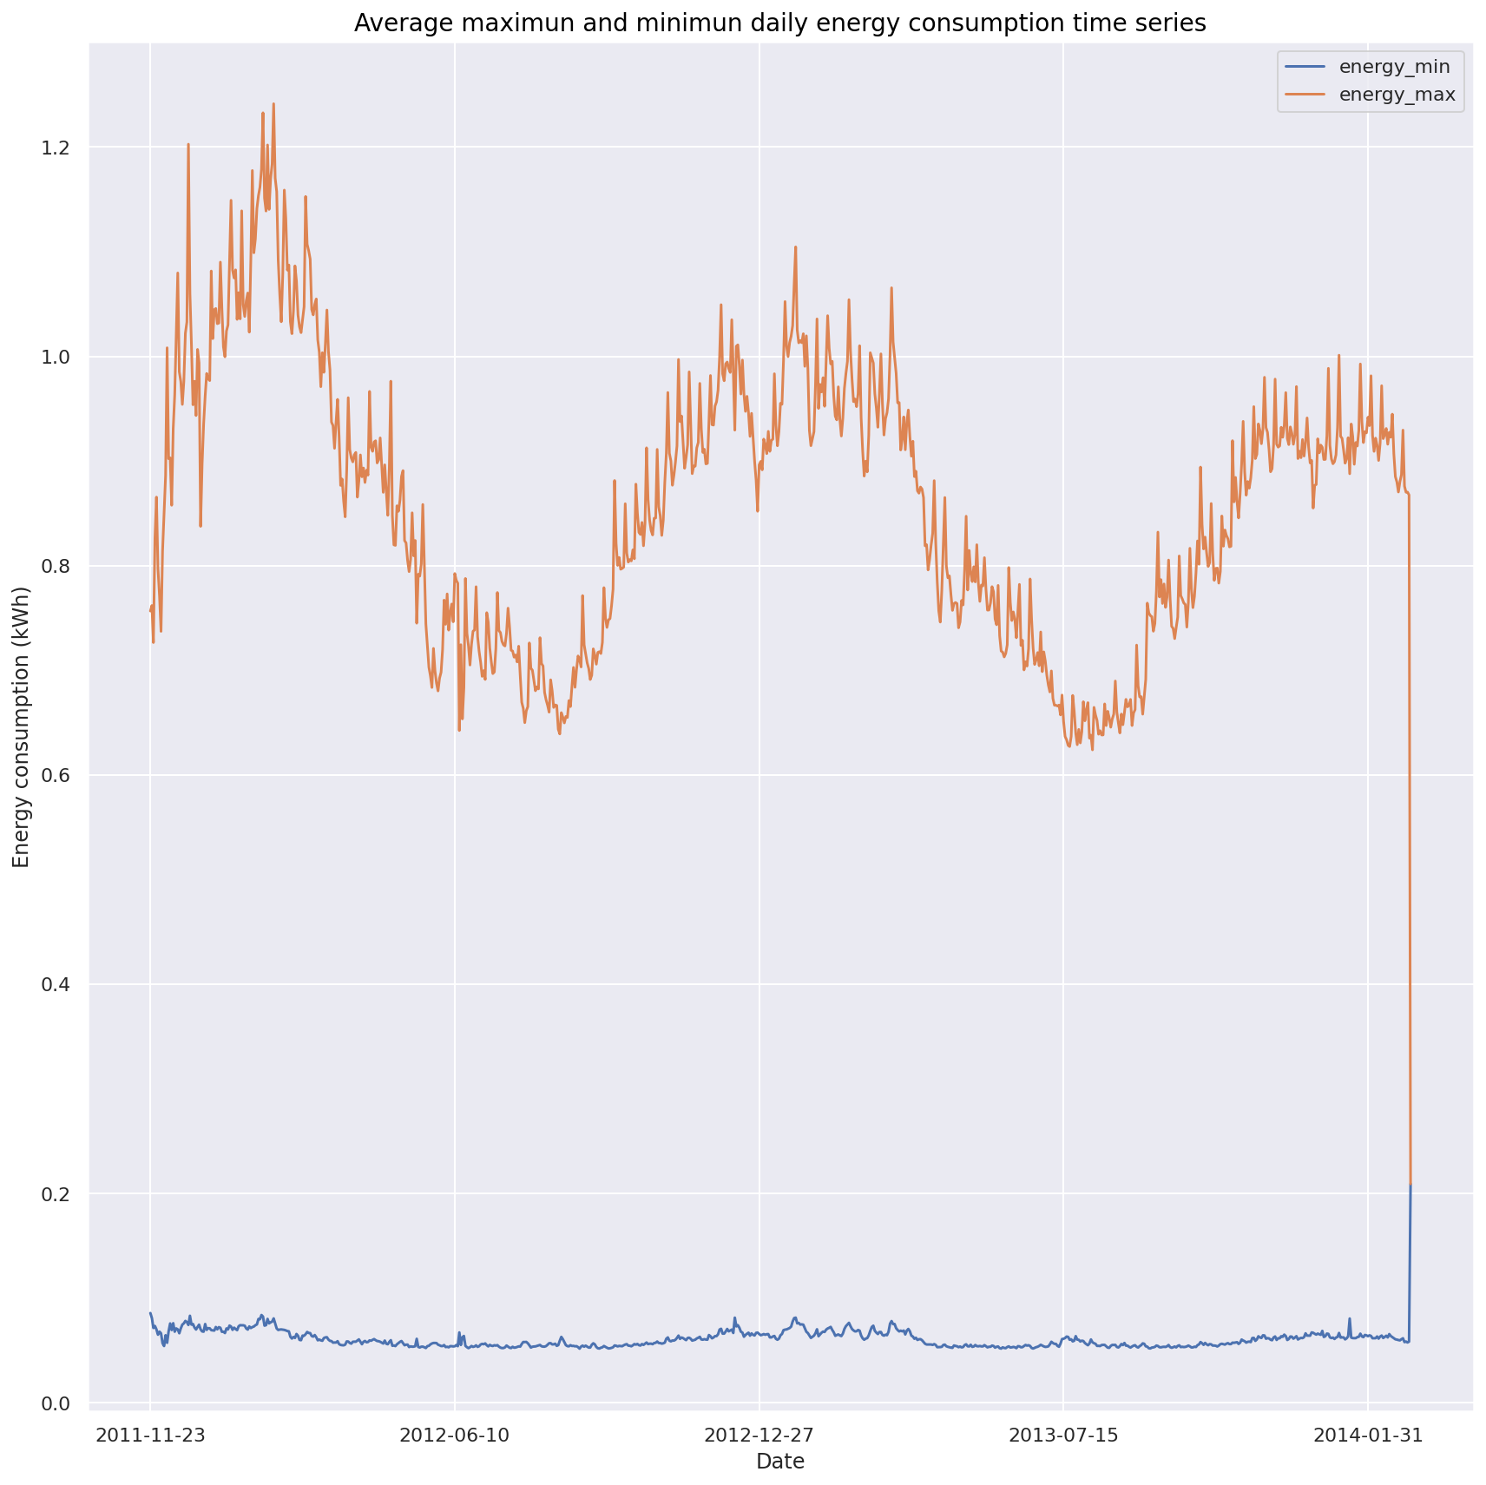
There is clearly a seasonal fluctuation for the average daily maximum hourly energy consumption, peaked around July and dropped in January, which matched the temperature seasonal fluctuation. Minimum daily average consumption is following the trend, but with much lower variation.

Slide 13
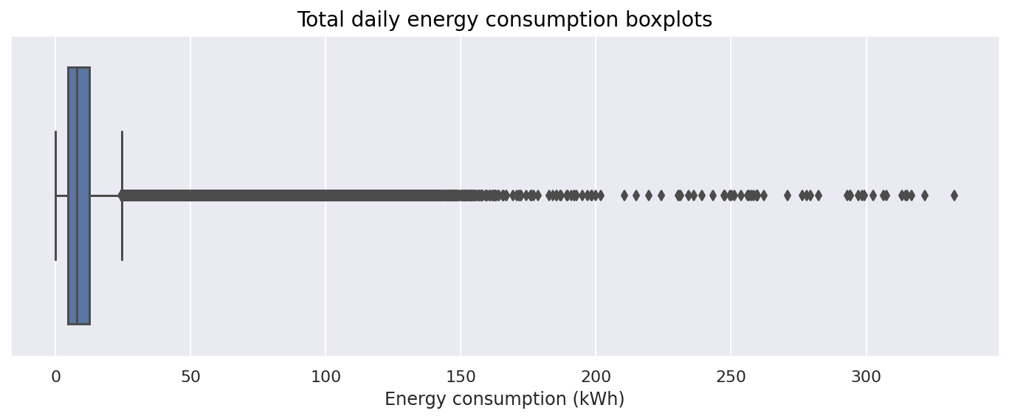
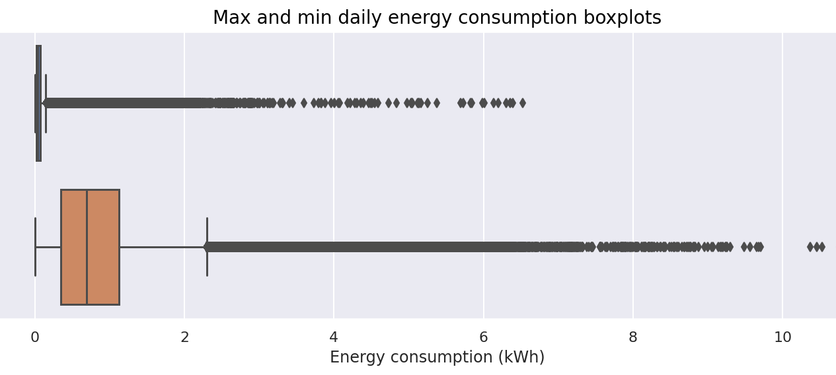
There are outliers in:
energy_min
energy_max
energy_sum

Slide 14
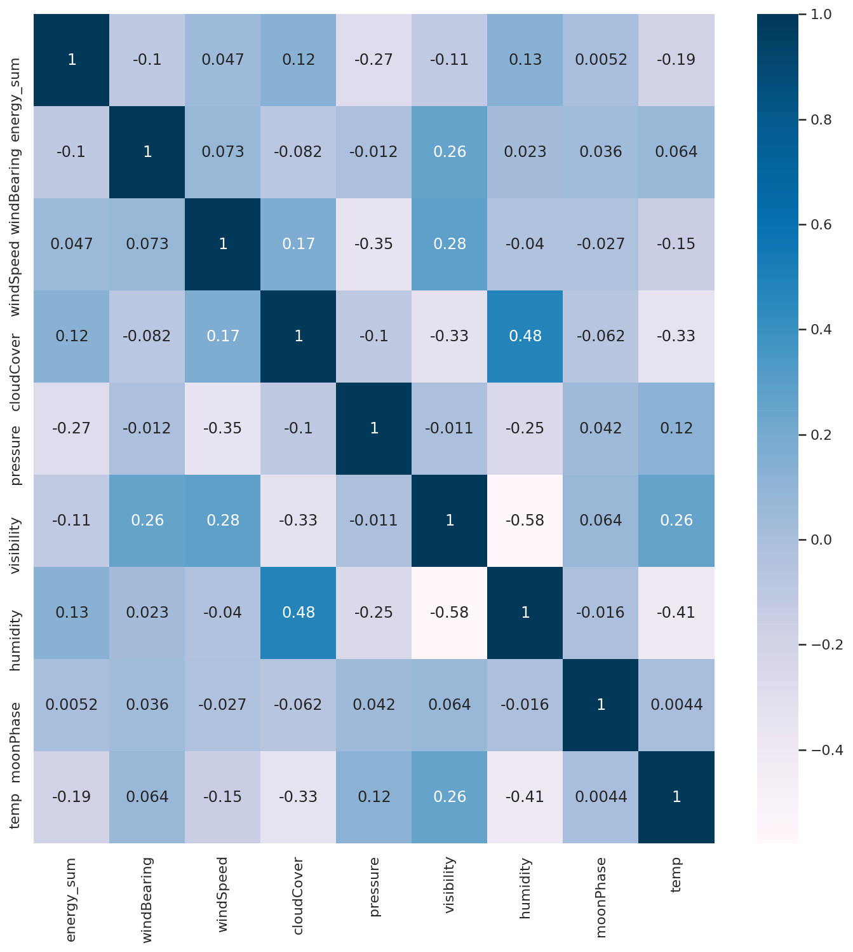
We then drop the all the other features apart from day and energy_sum, then sum up the energy_sum for each day.
We now have a dataframe with daily total energy consumption.
Then we join it with the weather dataset, and trying to predict the daily energy consumption later.
temp is the mean of temperatureMax and temperatureMin.
The heat map of the join dataset shows temp has the highest correlation coefficient of -0.19 with the label column energy_sum.

Slide 15
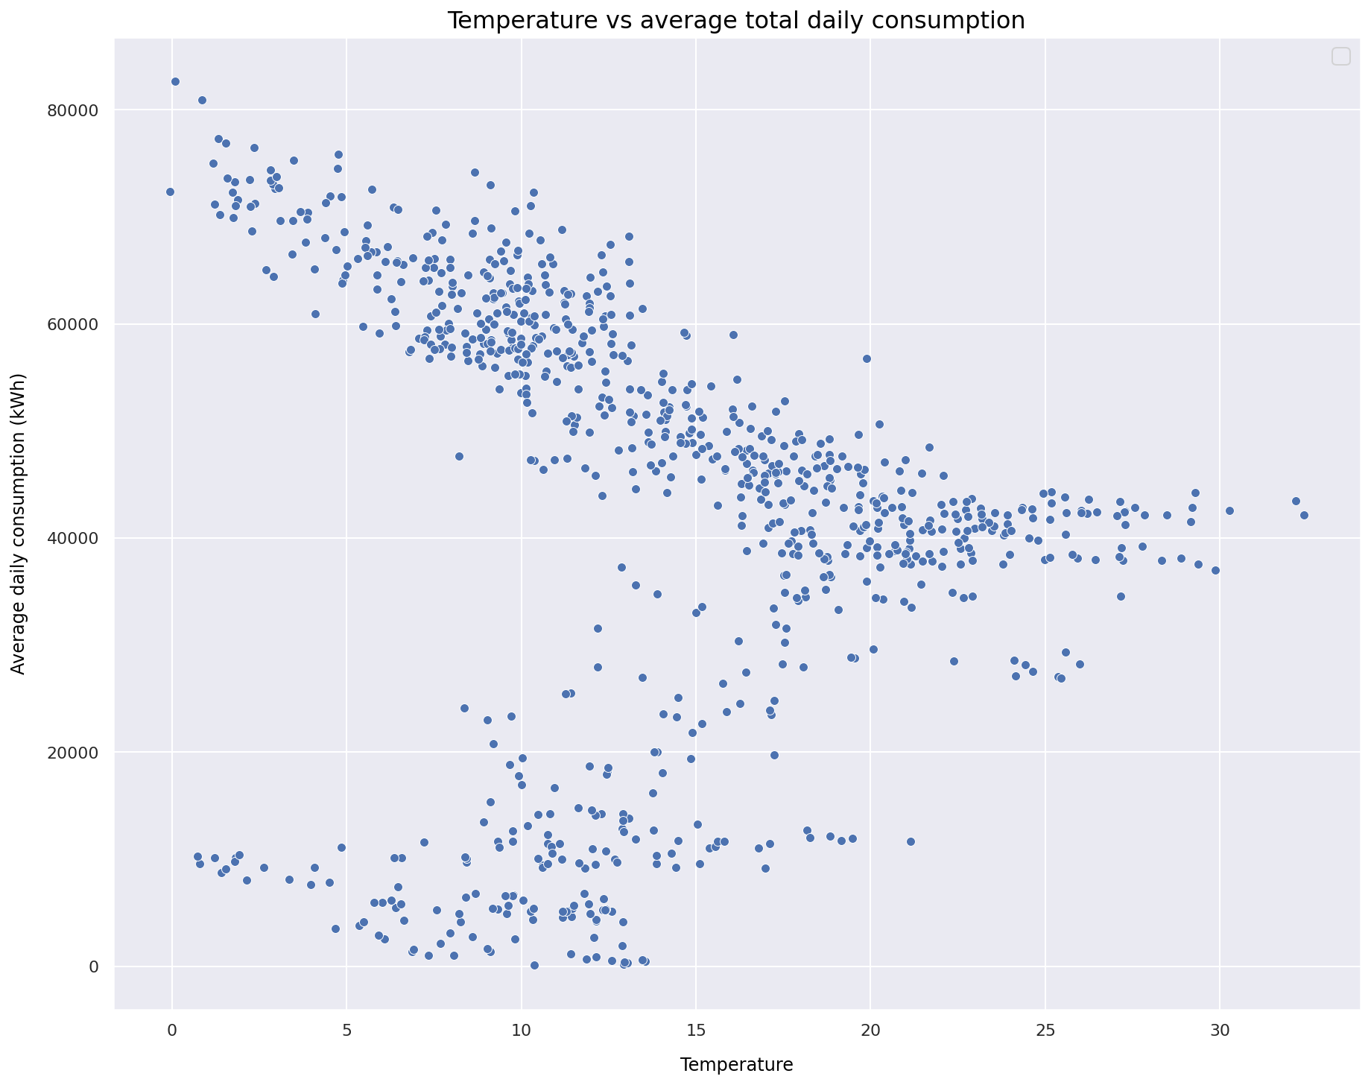
Above about 35000 kWh, there is a negative correlation between energy consumption and temperature. However, the correlation is positive below hat range. This might due to independent behaviour from low energy users or some commercial users. That left us with a noisy data.

Slide 16
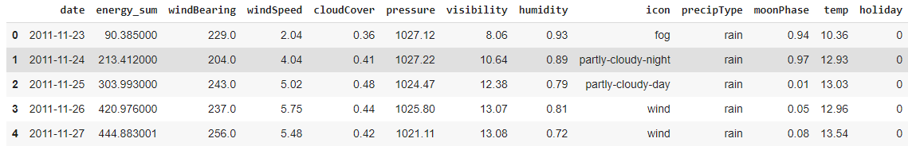
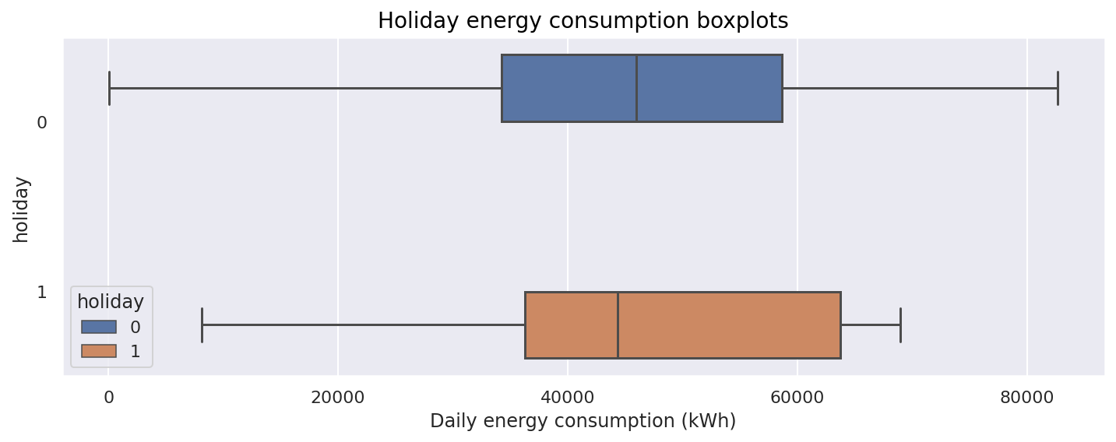
We then create a feature column, holiday, to show 1 if the date is in the Bank holiday column from uk_bank_holiday.csv, otherwise 0. The joint dataset as above. Energy consumers might have different energy consume behaviour during public holidays. The boxplot on the right shows during public holidays, energy consumption is lower with a slightly lower mean value, and within a smaller range. This might due to some commercial users isn’t operating.

